Slide 1
R Packages and Publicly Sourced Data
New Member Presentation
Megha Patel
Economist
Acceptance Testing Team

Slide 2
Background
Recent Master’s Graduate in Economic Development - VU
  Specialization: Economics of Poverty in Developed and Developing Countries, Microeconomics
Undergraduate Degree: Economics - RU
Skillset Coming in: R/RStudio, Python, STATA

Slide 3
What is a Package?
What is a Package?
  Packages in R are collections of functions and/or data that are bundled up for easy distribution. If an R user creates a package and thinks that it might be useful for others, that user can distribute it through a package repository.
  Packages can:
    Support Quality Control
    Create visuals
    Provide statistics
Notes:
Talking Points:
R/RStudio was designed to be flexible for the user

Slide 4
R Package: BLS APIs
https://cran.r-project.org/web/packages/blscrapeR/blscrapeR.pdf
Scrapes various data from The U.S. Bureau of Labor Statistics: the statistical branch of the United States Department of Labor. The package has additional functions to help parse, analyze and visualize the data.
Notes:
Type Package Title An API Wrapper for the Bureau of Labor Statistics (BLS) Version 3.2.0 Description Scrapes various data from . The U.S. Bureau of Labor Statistics is the statistical branch of the United States Department of Labor. The package has additional functions to help parse, analyze and visualize the data. Depends R (>= 3.5.0) Imports httr, jsonlite, ggplot2, magrittr, utils, stats, grDevices, dplyr, purrr, tibble, stringr Suggests testthat, knitr, rmarkdown License MIT + file LICENSE URL https://github.com/keberwein/blscrapeR BugReports https://github.com/keberwein/blscrapeR/issues LazyData true RoxygenNote 7.0.2 VignetteBuilder knitr NeedsCompilation no Author Kris Eberwein [aut, cre] Maintainer Kris Eberwein Repository CRAN Date/Publication 2019-12-17 18:20:02 UTC

Slide 5
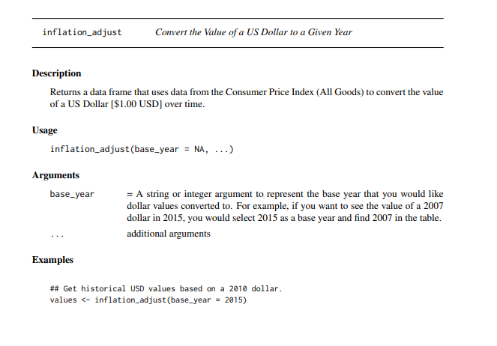
Notes:
https://cran.r-project.org/web/packages/blscrapeR/blscrapeR.pdf
Explicit use of the CPI using an R Package.

Slide 6
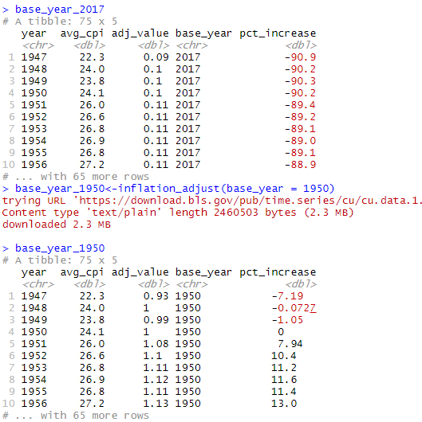
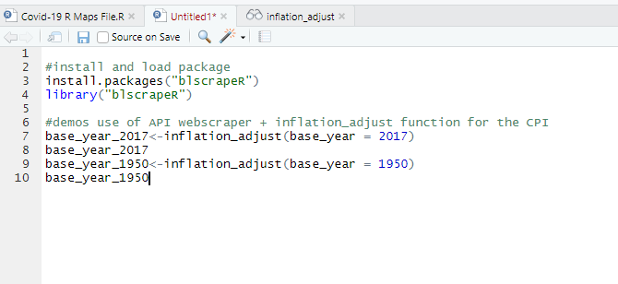
Notes:
Output of the inflation_adjust function using base year 2017 and 1950

Slide 7
R and RStudio Resources
https://www.rstudio.com/resources/
https://cran.r-project.org/
https://r4ds.had.co.nz/
https://www.rstudio.com/resources/cheatsheets/
https://r-graphics.org/index.html
https://cran.r-project.org/web/packages/dlookr/vignettes/diagonosis.html

Slide 8
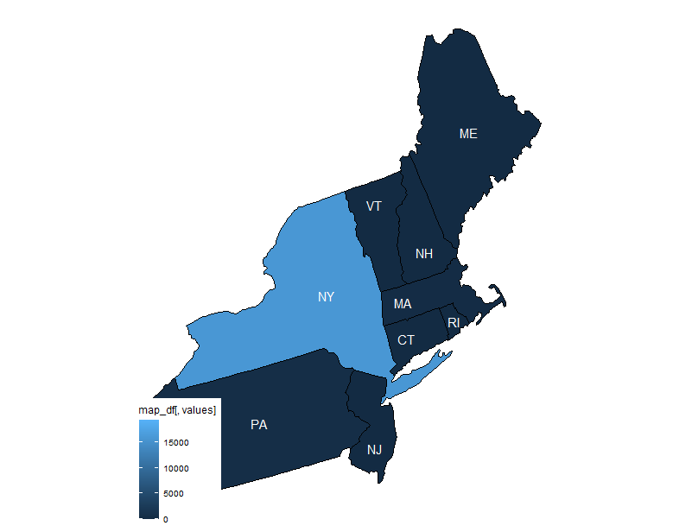
Ex. Simplifying Your Workload
R Project: Mapping Covid-19 Cases Jul-2020
Desc: Takes New York Times Covid-19 data and creates maps based on region. Saves individual maps in file folder as images. Meant to be used weekly.
Self Contained? – Yes
Packages Used: 4
Shareable to other R users? Yes
Data Source:
  https://github.com/nytimes/covid-19-data
Notes:
"Probable" and “Confirmed Cases and Deaths
Cases and deaths can be reported as either “confirmed” or “probable.” Our total cases and deaths include both. The number of cases includes all cases, including those who have since recovered or died.
On April 5, 2020, the Council of State and Territorial Epidemiologists advised states to include both confirmed cases, based on confirmatory laboratory testing, and probable cases, based on specific criteria for testing, symptoms and exposure. The Centers for Disease Control adopted these definitions and national CDC data began including confirmed and probable cases on April 14, 2020.
Some governments continue to report only confirmed cases, while others are reporting both confirmed and probable numbers. And there is also another set of governments that is reporting the two types of numbers combined without providing a way to separate the confirmed from the probable.
The Geographic Exceptions section below has more details on specific areas. The methodology of individual states changes frequently.
Confirmed Cases
Confirmed cases are counts of individuals whose coronavirus infections were confirmed by a laboratory test and reported by a federal, state, territorial or local government agency. Only tests that detect viral RNA in a sample are considered confirmatory. These are often called molecular or RT-PCR tests.
Probable Cases
Probable cases count individuals who did not have a confirmed test but were evaluated by public health officials using criteria developed by states and the federal government and reported by a health department.
Public health officials consider laboratory, epidemiological, clinical and vital records evidence. Tests that detect antigens or antibodies are considered evidence towards a “probable” case, but are not sufficient on their own, according to the Council of State and Territorial Epidemiologists.
https://github.com/nytimes/covid-19-data

Slide 9
Megha S Patel
732-762-8181
patel.megha@bls.gov

